Slide 1
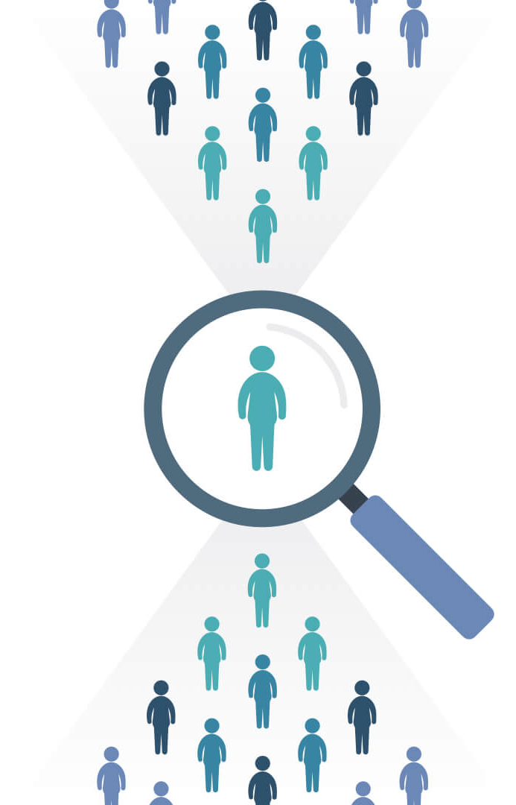
HUMAN RESOURCES REPORT Transforming Data into Actionable Insights
~By Nandini Toshniwal

Slide 2
INTRODUCTION
1. TECHNOLOGY USED:
Excel: Excel is a spreadsheet tool by Microsoft used for organizing and analyzing data.
Power BI : Power BI is a business analytics tool by Microsoft that enables users to visualize data, create interactive dashboards, and generate reports.
2. DATASET SOURCE:
Kaggle: Kaggle is an online platform which offers a vast library of free datasets.
3. DATASET TYPE:
HR Workforce Analytics
4. DATASET DESCRIPTION:
A comma separated file(csv) that contains 161 rows, 9 columns

Slide 3
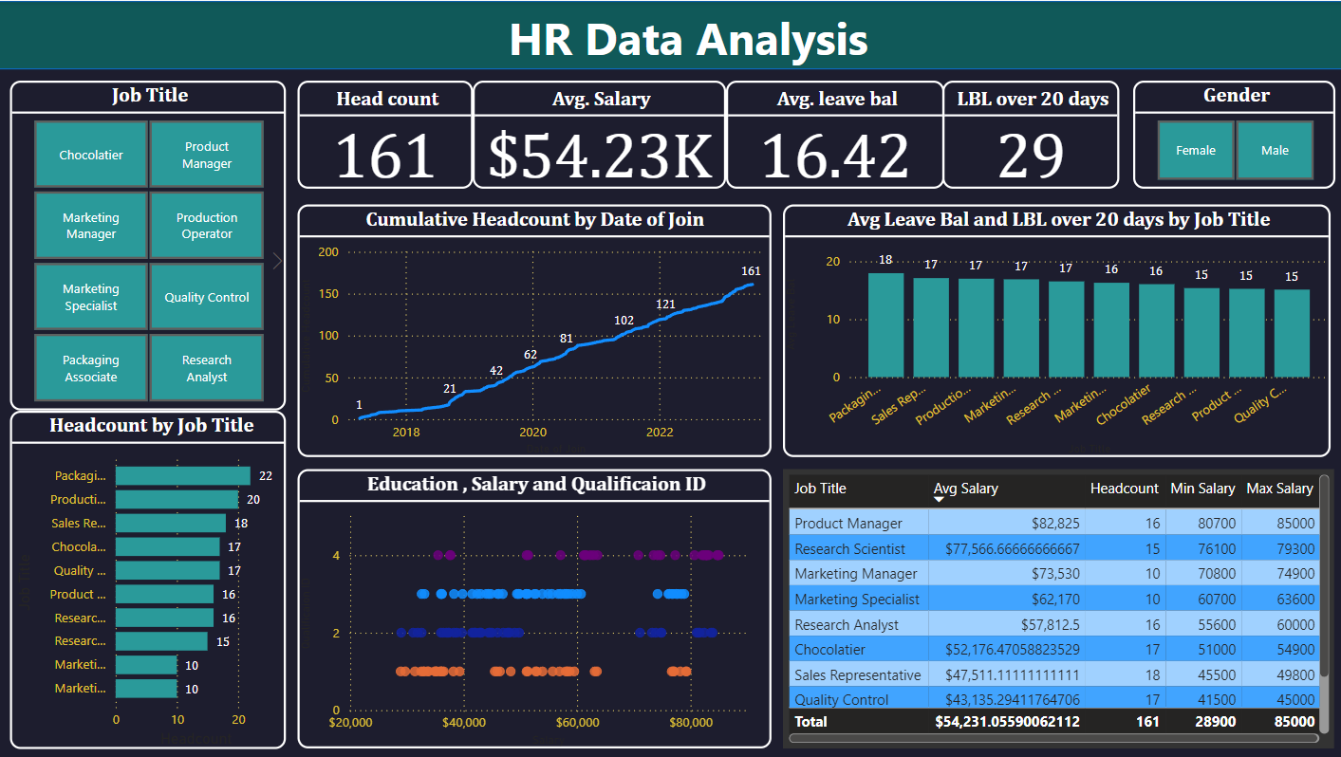
DASHBOARD

Slide 4
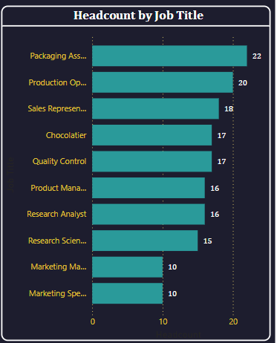
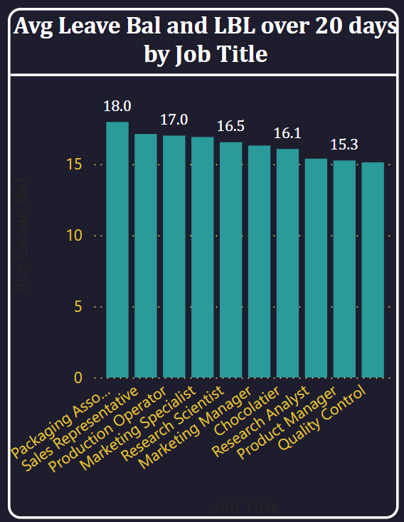
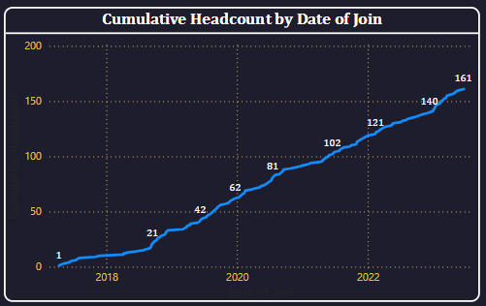
INSIGHTS
Packaging Associates, Production Operations and Sales Representative are most popular jobs in the company and Marketing management or Marketing Specialists are comparatively less popular.
The Headcount shows a consistent growth since 2018 which reflects company expansion phases. Significant jumps are seen around 2020 (62) and 2022 (121). Growth from 2022 to 2023 is moderate, increasing from 140 to 161.
Highest Leave Balance indicate greater flexibility in their schedules.
Moderate Leave Balances indicate their operational nature requires consistent availability.
Lowest Leave Balance
suggest higher workload demands.

Slide 5
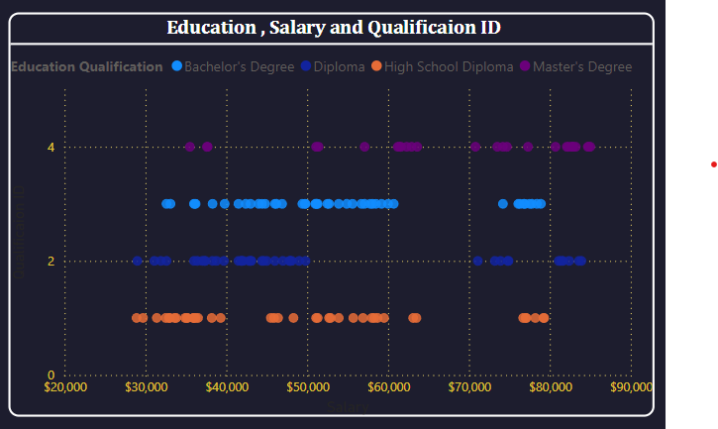
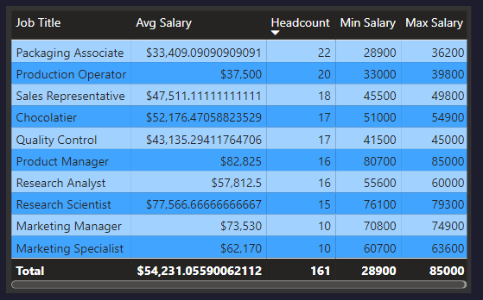
INSIGHTS
High School Diploma holders are clustered in lower salary ranges.
Bachelor’s and Master’s Degree holders dominate higher salary bands
The broader distribution of salaries for Diploma and Bachelor’s Degree holders suggests diverse roles for these education levels.
Master’s Degree holders reaching a salary plateau suggests limited opportunities for advancement.
Significant salary differences exist between operational roles (e.g., Packaging Associates at $33,409) and managerial/specialized roles (e.g., Product Managers at $82,825).
The total workforce count is 161 employees, with an average salary of approximately $54,231. This indicates that operational roles (with higher headcounts but lower salaries) dominate the workforce costs.

Slide 6
CONCLUSION
In conclusion, this HR analysis provides a comprehensive overview of the company's workforce, highlighting key trends in headcount distribution, salary structures, and employee retention.
The data reveals that operational roles, while numerous, have a lower average salary compared to specialized and managerial positions, which indicates the company's investment in skilled and strategic roles.
Additionally, the cumulative growth in employee headcount demonstrates consistent expansion, particularly in recent years.
Moving forward, the company may want to focus on optimizing workforce allocation, salary competitiveness, and employee development initiatives to ensure continued growth and retention.

